Slide 1

DEPARTMENT OF CSE
CSE220: INTERNET OF THINGS
TITLE OF POJECT : Alcohol sensing alert with engine locking system
UNDER THE GUIDANCE OF: Mr. Afroz Pasha, Ms.Preethi C, Ms.Amreen Ayesha
GROUP MEMBERS :
Neha A – 20181CCE0061
Sujata Shivanand Gotyal-20181CCE0088
Suundesh – 20181CCE0091
Afzal- 20181CCE0094
Yogita Singh – 20181CCE0104

Slide 2
ABSTRACT
The main aim of our project is to make human driving safe and to over come accidents caused by drink and drive.
This project is developed by integrating alcohol sensor with Arduino board.
The alcohol sensor used in this project is MQ3 which is used to detect the alcohol content in human breath.
Since, sensors has the fine sensitivity range around 2 meters, it can suit to any vehicle and can easily be hidden from the suspects. This project is can be fitted inside the vehicle.
This project is designed for the safety of driver , pedestrians, and the drivers on the road.

Slide 3
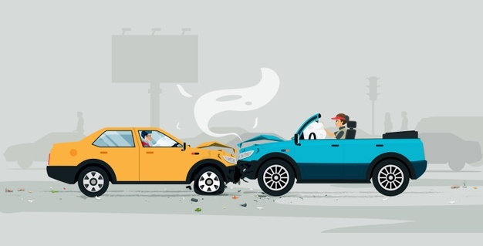
INTRODUCTION
Drinking and driving is already a serious public health problem, which is likely to emerge as one of the most significant problem in near future, the system implemented by us alarms at reducing the road accidents in then near future due to drink and drive.
This device senses a change in the alcoholic gas content of the surroundings air these devices is more commonly referred as a breath analysis, as it analysis the alcohol content from person’s breath.

Slide 4
Advantages
Prevent accident due to drink and drive.
Easy and efficient to test the alcohol content in the body.
The life and property loss chances will be minimised.
Quick and accurate results.

Slide 5
hardware used
Arduino uno
Alcohol sensor
Relay module
9Volt battery
DC motor
Jumper wire
LCD display
Buzzer

Slide 6
Requirement study

Slide 7
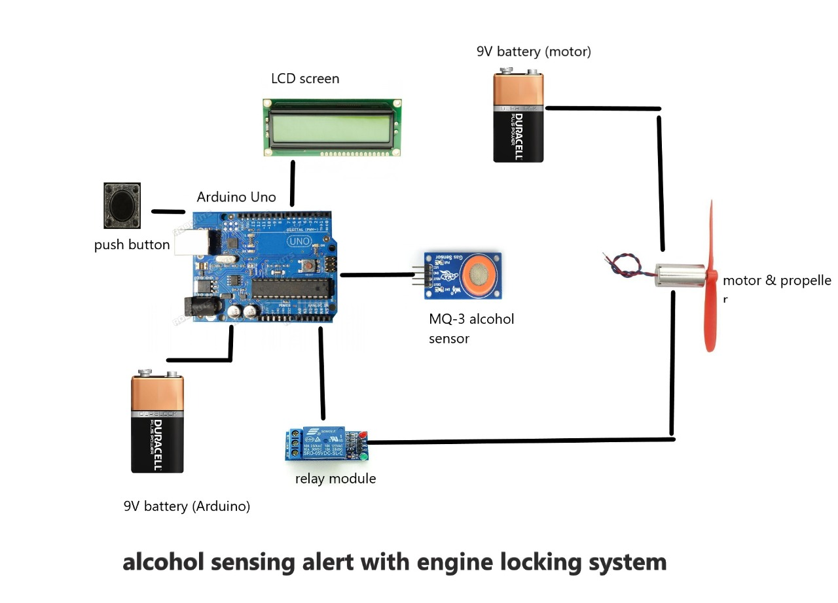
circuit design

Slide 8
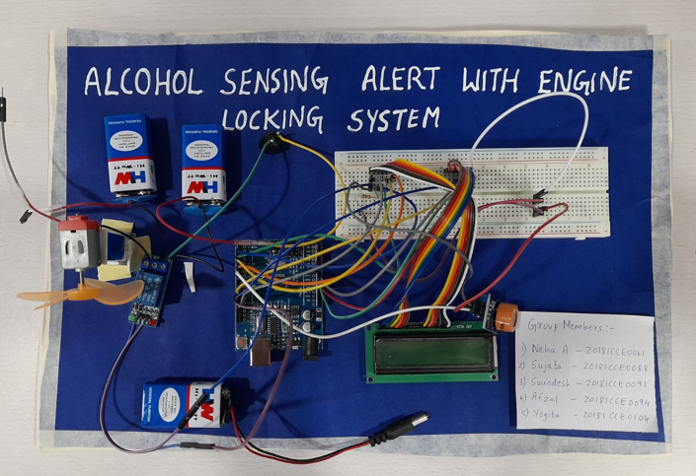
Final circuit design

Slide 9
reSULT AND CONCLUSION
We have provided a very effective solution to develop an intelligent system for vehicles for alcohol detection whose core is Arduino.
Future scope of this system is to control the accidents causes due to alcohol consumption.
This system improves the safety of human being. And hence providing the effective development in the automobile industry regrading to reduce the accidents cause due to alcohol.

Slide 10
THANK YOU

